Slide 1
ECE-777 System Level Design and Automation
Specification languages
Cristinel Ababei
Electrical and Computer Department, North Dakota State University
Spring 2012

Slide 2
Overview
General language characteristics
Harel’s StateCharts
UML Statecharts
Statemate
SDL
SystemC
SpecC
VHDL, Verilog, SystemVerilog
Simulink
C, C++, Java

Slide 3
Specification language requirements
Hierarchy
  behavioral and structural
Compositional behavior
  Must be “easy” to derive behavior from behavior of subsystems
Timing behavior
State-oriented behavior
  classical automata models are insufficient
  Required for reactive systems
Event-handling
  External (caused by the environment) or internal events (caused by the system)
No obstacles to the generation of efficient implementations
Support for the design of dependable systems
  Unambiguous semantics and capable of describing security and safety requirements
Exception-oriented behavior
  Not acceptable to describe exceptions for every state

Slide 4
Concurrency
Synchronization and communication
  Concurrent actions have to be able to communicate
Verifiability
Presence of programming elements
  Programming languages have proven to be convenient for the expression of computations
  Classical state diagrams do not meet the requirement
Executability
  The possibility to execute a specification is a way for checking it
Support for the design of large systems
  Software technologies has found object orientation mechanism for designing large systems

Slide 5
Domain-specific support
  Language feature dedicated to control/data-dominated or centralized/distributed applications
Readability
  Specification must be readable by the human being
Portability and flexibility
  Small changes of the system’s features should require small changes to the specification
Non-functional properties
  Fault tolerance, size, expected lifetime, power consumption, electromagnetic compatibility, extendibility etc.
Termination
Support for non-standard IO-devices
Appropriate model of computation
It is obvious there will be no formal language meeting all these requirements. Compromises will have to be made.

Slide 6
A note on timing: Problems with classical CS theory and von Neumann computing
“The lack of timing in the core abstraction is a flaw, from the perspective of embedded software, …”
  Ed Lee, Absolutely Positively on Time, IEEE Computer, July 2005.
“Timing is everything”
  Frank Vahid, WESE 2008
Even the core … notion of “computable” is at odds with the requirements of embedded software
  In this notion, useful computation terminates
  In embedded software, termination is failure
  Subcomputations must terminate with predictable timing
“What is needed is nearly a reinvention of computer science”
  Ed Lee, Absolutely Positively on Time, IEEE Computer, July 2005.

Slide 7
General language characteristics
Synchronous and asynchronous languages
  Languages based CFSMs and sets of processes (ADA, Java) are non-deterministic, since the order in which executable processes are executed are not specified
  Synchronous languages avoid non-determinism: Esterel, Lustre, StateCharts
Process concepts
  Number of processes can be either static (e.g. StateCharts) or dynamic
  Processes can be statically nested or declared at the same level
  Techniques for process creation exist
  Concurrent process model
    http://esd.cs.ucr.edu/slides/ch8_011702.ppt
    http://theory.stanford.edu/~rvg/process.html

Slide 8
General language characteristics
Synchronization and communication
  Shared memory – all variables can be accessed from all processes
  Message passing – messages are sent/received just like mails over the Internet. Generally slower.
Specifying timing. Four requirements:
  Access to a timer – a means to measure elapsed time
  Means for delaying a process (e.g. “wait for” in VHDL)
  Possibility to specify timeouts (e.g. StateCharts allows timeouts)
  Methods for specifying deadlines and schedules
Using non-standard IO/devices
  E.g. ADA allows variables to be mapped to specific memory addresses

Slide 9
Overview
Harel’s StateCharts
UML Statecharts
Statemate
SDL
SystemC
SpecC
VHDL, Verilog, SystemVerilog
Simulink
C, C++, Java

Slide 10
Harel Statecharts
Introduced by David Harel in 1987 - provide compact and expressive visual formalisms for reactive systems.
What are Statecharts?
  Viewed as both model and graphical specification language.
  Describe communicating finite state machines - Visual formalism for describing states & transitions in modular fashion.
What is the purpose of using Statecharts?
  To suppress and organize detail.
  Best if graphical. The clarity they provide can be lost if they are represented in tabular form.
  Allows the super states to have history. History is helpful for back-up, if system fails.
The Harel statechart is equivalent to a state diagram but it improves the readability of the resulting diagram.
It can be used to describe many systems, from computer programs to business processes.

Slide 11
Harel Statecharts
They are directed graphs and used to describe the behaviour of an object. The vertices are the states an object can reach. Edges are changes of the state, the so-called transitions.
Statecharts based on a generalization of the concepts of FSMs. It’s considered that the computing power of statecharts is the same as that of Finite State Machines.
Recent paper argues that the computation power of statecharts is far beyond that of Finite Automata and that Interaction Machines are the most accurate theoretical models for statecharts
Used as a modeling tool and adopted by Unified Modeling Language (UML) as an important technique to model the dynamic behavior of systems.

Slide 12
State-Transition Diagram vs. Statechart
F
G/A E/ B
S
S
E
E
F
F
U
G/A
E/B
U
F
T
G/A
T
G/A
State-transition diagram
Statechart
The statechart reduces the number of transitions when compared to STD.
G/A represents that for event G action A takes place.
S & T are combined together into a super-state F (OR- property of the statechart)

Slide 13
State-Transition Diagram vs. Statechart
Property | State-transition Diagram | Statechart
Super-states | Absent | Present
History | Absent | Present
Concurrency | Absent | Present
Broadcast Communication | Absent | Present
Synchronization & Timing Info | Absent | Present
Hierarchical Structure | Absent | Present

Slide 14
Statecharts development
2 Types of statechart development
  Harel Statecharts
    Developed by David Harel.
    First developed for function-oriented systems.
    Later extended for OO systems with few changes.
  UML Statecharts
    Developed by Object Management Group (OMG).
    Extended the properties of Harel statecharts with some new features.

Slide 15
Example: Harel Statechart
E2/A2
A
R
T
E1/ A1
U
J
W
H
E
F[ in (Y)]
G
K
X
V
Y
E
Harel Statechart showing properties of orthogonality, and-decomposition, History, Clustering, Refinement, Forking issues.
E/A -Represents that for event E, action A will take place.
Dashed line represents the AND-product (orthogonality) of states R & T.
F[in(Y)]: The function in [] (i.e. in(Y)) represents the guard condition.

Slide 16
Example: Equivalent STD
If there are n states in one side of the dashed line in a super-state and m states in the other side, then the total number of maximum states in the equivalent state-transition diagram will be the product m*n.
A
U_X
K
A
U_W
G
U_Y
E
E
E
F
G
V_W
V_Y
E
J
V_X
K

Slide 17
1. Decomposition: OR-State, AND-state
A superstate may be decomposed into any number of OR-states. When the object is in the superstate, it must be in exactly one of its OR-substates.
S is decomposed into X & Y. At any given time S will be either in X or Y but not both.
The default start state in S is X. t1 & t0 are the events depending on which the S will be in either X or Y
S
X
t1
t0
Y
OR State
C
A superstate may be decomposed into any number of AND-states. When the object is in the superstate, it must be in every active AND-substates (shown with dashed lines).
C is the superstate formed by the AND product of A & B.
X & R are the default initial states of A & B respectively. When the system enters C it will be present in both X & R at the concurrent time.
X
R
t1
t0
t6
t1
Y
S
A
t3
B
Z
AND State

Slide 18
2. Clustering & Refinement
Clustering is a bottom-up concept & refinement is a top-down one; both give rise to the OR-relationship between a state’s sub-states.
Reduces the number of transitions in a statechart.
Superstate R & T can be extended if needed in order to view the sub-states and their internal transitions, which is called refinement.
S
E
A
S
E
F
U
G/A
E/B
U
G/A
E/B
F
F
T
G/A
T
G/A
Simple State Diagram
Clustering of States
States S & T are clustered into a single super-state A.
Expanding A & showing its sub-states is refinement.

Slide 19
3. History
History (H), in a statechart gives the most recently visited state of the super-state that it is entering.
Shallow History (H): Represents the most recently entered state at the same level.
Deep History (H*): Represents entering the most recently visited state irrespective of how deep the state is.
History is “forgotten” if dead has been entered in the meantime.

Slide 20
H – History chooses between G & F. H remembers between A,B,C,D,E.
H remembers the last sub-state (both history and sub-states should be at the same level) the system left.
H* - System will enter the most recently visited state (A-E)
H* remembers the last sub-state the system left, irrespective of how deep it may be when considered with the history state.
B & C are the default initial states for G & F.
K
H/H*
G
F
C
D
A
E
B

Slide 21
4. Orthogonality
5. Overlapping states
Orthogonality
  Reduces the number of states.
  Viewed as the AND product of two states (consisting of sub-states) which gives a certain kind of synchronization.
  Generalization of the usual product of automata with some dependence between components (like common events or conditions).
Overlapping states
  A state which is present in both the super-states.
  Overlapping states removes redundancy.
  Turns XORs state machine into ORs.
  Causes semantic problems especially when the overlapping involves orthogonal components.

Slide 22
Sub-state “C” is present in both A & D, i.e. the relation between A & D is OR.
Too much of overlapping should be avoided as it leads to unnecessary burden & complexity.
A
a
B
b
C
D
E
F

Slide 23
6. Delays & Timeouts (event, number)
Represents the event that occurs precisely when the specified number of time units has elapsed from the occurrence of the specified event.
Has lower bound and upper bound attached to each of the timeouts and events.
Lower Bound: If events are to cause exits, events do not apply in the state until the lower bound is reached.
Upper Bound: The event has to take place in that time.

Slide 24
7. Conditions & Selection Entrances (C & S)
Condition (C): Upon the entrance of the super-state a condition is checked and the transition is made to one of the sub-states in the super-state.
Selection (S): The transition is made depending on a generic value of the input rather than the condition.

Slide 25
Conditions & Selection Entrances (C & S)
C represents the conditions.
The state entered depends on whether C evaluates to P, Q or R and states reached will be Z, X, Y respectively.
On entering the super-state, which state (whether X,Y,Z) to enter depends on the what the condition C evaluates to.
X
Q
Z
P
Y
C
R
a
The decision to enter one of the three states, A, B, C depends on what will be the generic value of S.
A
B
Reset
Execute
Data Entered
C
Set_up
S

Slide 26
More properties
8. Harel statechart is a mix of Mealy and Moore state machines and flowchart.
9. Fork & merge (see figure).
10. Broadcast feature in statecharts.
E1/A1
B
C
A
F
D
E
E2/A2

Slide 27
Shortcomings of Harel Statecharts
Semantics: How to represent?
  No specified approach.
  Many papers published, each having one flaw or other, none giving the complete formal semantics.
  Harel introduced STATEMATE CASE tool to deal with this but that paper too had one debatable topic.
Notion of time
  Assumption: Transitions take zero time (not possible for RT systems).
  No way to tell whether how long the system can stay in a particular state.
Determinism
  What should be done in case an event may result in multiple transitions each leading to a different state?
  Which one of the transitions must have precedence over others?
  Leads to non-deterministic situation.
Race condition: What will be the resulting value?
  Non-determinism of statechart may result in race condition for the system.
  Multiple transitions on multiple states may occur for the same event, and may attempt to modify the same value.

Slide 28
Shortcomings: non-determinism
Priority should be given to transitions so as to eliminate the non-determinism.
On entry into the superstate S, both the sub-states are traversed concurrently.
When the system exits S, it is not sure what the values of X & Y will be, it depends on which one of the events triggered first (i.e., if E in S1 is triggered first then the values of X and Y both will be 1, else X will be assigned to 1 and the value of Y depends what X was prior to being assigned 1).
This leads to non-determinism in the system.
S
S11
S1
S2
S21
E/X=1
E/Y=X
S12
S22

Slide 29
Shortcomings: race condition
Race Situation: What is the value of X after state “S” is exited?
There is race condition in the system. The value of X depends on which of the events i.e. E in S1 or E in S2 triggered last.
S
S11
S1
S2
S21
E/X=1
E/X=2
S12
S22

Slide 30
Shortcomings of Harel Statecharts
Infinite loops:
  Doesn’t define the property of consistency check in its model.
  The flaw in the design may lead to infinite loop while the system is being designed.
Inconsistency in free transitions:
  Inconsistency when an exit transition leaving a composite boundary happens to be an unlabelled transition.
Statecharts do not support any dynamic semantics to cover their precise behavioral aspects.

Slide 31
Conclusion
StateCharts’ main application domain is that of local, control-dominated systems.
Key advantage is the property of nesting hierarchies.
Examples of tools based on StateCharts: StateMate, StateFlow, BetterState. Many can translate StateCharts into equivalent C or VHDL, from which hardware can be synthesized.

Slide 32
Further info
http://ls12-www.cs.tu-dortmund.de/daes/media/documents/staff/marwedel/es-book/slides10/es-marw-2.02-fsm.ppt
http://chess.eecs.berkeley.edu/design/2010/mocFSM-CFSM.pdf

Slide 33
Overview
Harel’s StateCharts
UML Statecharts
Statemate
SDL
SystemC
SpecC
VHDL, Verilog, SystemVerilog
Simulink
C, C++, Java

Slide 34
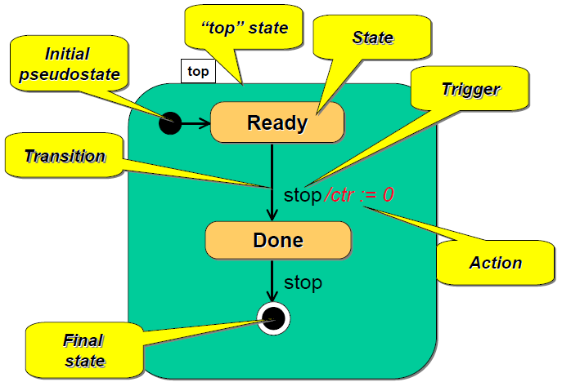
Basic UML Statechart Diagram

Slide 35
UML statecharts
Harel statecharts are the basis for UML statecharts.
Harel statecharts were mainly designed for function-oriented structured analysis design techniques, later extended for OO technology.
Statecharts were introduced in UML with modifications in the semantics and some in-build terminology.

Slide 36
Example
UML statechart showing properties of orthogoanlity, and-decomposition, History, Clustering, Refinement, Forking issues, pseudostates, Synch pseudostates.
G
C1
F
C2
E1/A1
A
D1
D2
F
B
D3
E2/A2

Slide 37
UML Statecharts: Properties
Object Behavior:
  An object can be in different states depending on the present value of the variables and data types it has.
  The object behavior can be represented in three different types:
  Simple behavior: Doesn’t depend on history of the previous inputs or services. E.g. simple mathematical functions.
  State behavior: The entire system or space is divided into states.
  Continuous behavior: Depends on object’s time history.
2. Delays & Timeouts:
  Statechart transitions are modeled to take insignificant amount of time.
  A guard and a trigger represent a transition. They are of two types of triggers:
    Named Trigger: Results in transition.
    Null transition: Evaluated only once upon entrance to the source state.
  Assumption: Evaluation of conditions, guards and triggers takes zero amount of time.
  Timeouts are there in UML statecharts.

Slide 38
Null transition
Null Triggered transition G is implemented immediately after Start() & Execute(). If g evaluates to false then the only way it will ever be evaluated is if event R occurs retriggering the null-triggered transition.
S
Entry / Start()
Do / Execute()
T
[G]
E

Slide 39
UML Statecharts: Properties
3. UML statecharts define 4 types of events:
  Signal: Event due to extended asynchronous process.
  Call: Execution of an operation within the object.
  Change: Change in value of an attribute.
  Time: Lapse of a time-interval.
Message passing between different diagrams
5. Priority given to transitions with the innermost source state.
B
Enter: f(a)
Exit: g()
First f(a) is
then x()
B1
A
Enter: x()
Exit: y(a, b)
First y(a, b)
then g()
Execute from outermost first – for entry
Execute from innermost first – for exit

Slide 40
UML Statecharts: Properties
6. Actions and Activities:
  Activities: Performed as long as the state is active, interpreted and terminated by the receipt of an incoming event.
  Actions: Usually short, non-interruptible behavior while activities longer, interruptible behavior.
7. Fork & Join in UML.
8. Two different kinds of state machine formalisms:
  Statechart Diagrams: Used when state transitions takes place when an event of interest occurs.
  Activity diagrams: Changes state primarily upon completion of the activities executed.
9. UML statecharts have some dependence on abstract state machines along with Mealy’s. Harel statecharts are mainly based on Moore’s
10. Events can carry parameter, which Harel’s statechart doesn’t support.
11. Conditional guards.
12. Guards & explicit state machines.
OnButtonPushed [Guard Condition] /
Action:= Start();ControlPanel.UpdateState(Start)
Off
On
Message: OnButtonPushed
Guard: Guard Condition
Action: Start() [Internal Action]
ControlPanel.UpdateState(Start) [External Action]

Slide 41
UML Statecharts: Properties
13. Pseudostates.
  A kind of state vertex in the UML metamodel that represent transient points in transition paths within a state machine.
  Vertical bars indicate where concurrent behavior begins or ends (called pseudostates)
  E.g. Start state, Terminal state, Connectors etc.
14. Synch Pseudostate
  Allows a special kind of guard in which a “latch” remembers that a specific transition has occurred
  Similar to Petri net “place” with explicitly indicated capacity
  Must synchronize across AND-States
Synch Pseudostate
G
C1
F
C2
E1/A1
A
D1
D2
C
F
B
D3
E2/A2
Pseudostates

Slide 42
Symbols
Symbol
Pseudostate Name
Symbol
Pseudostate Name
Branch
H
Shallow History
C
OR
H*
Deep History
Terminal
T
OR
Initial/Default
Synch
Junction
*
OR
n
Choice Point
Fork
Merge Junction
Join
Stub

Slide 43
Shortcomings of UML statecharts
No discussion of extension mechanisms of statechart diagrams.
Do not support overlapped states:
  But the same functionality can be achieved without the use of overlapped states, though overhead involved to design it increases .
Boundary crossing violates encapsulation:
  Boundary crossing (supported by UML) is the practice, which violates the encapsulation of hierarchical states machines.
Non-determinism:
  UML’s reversed priority rule for resolving inter-level concurrency conflicts introduces non-determinism in the outer state machine.
Representation of states:
  UML statecharts can properly represent only one distinct accept state in a sub-state machine.
Exit Paths:
  In UML all the exit paths are subsequently merged in the single completion transition leaving the composite state boundary.

Slide 44
Example: Mobile Phone System
[BS Server Shutdown or in saturation of capacity]
Active
[MSC Server Shutdown]
Dial Digit (n)[Incomplete]
Dial
Power ON [Simulation]
Dial Digit (n)[Valid]
Idle
Hang Up
Receive
IP & Port
successfully
Call
[Wrong #]
Send Frame
Send a Call
Talk
Connect
MSC Server
Idle
Start
MSC Server Active
BS Server Idle
Start
BS Server Active
Ready
Ready
Shut Down
Receive a call
[Correct #]
Shut Down
Receive Call
[Regular Call]
Assigning
RegularCall

Slide 45
Comparison
Property | Harel Statechart | UML Statechart
Nesting & Orthogonal Regions | Supported | Supported
Single transition represents the same event from different sub-states | Supported | Supported
Broadcast events. | Supported | Supported
History | Supported | Supported
Sub-machines | Supported | Supported
Overlapping states | Supported | Absent
Pseudostates | Absent, but connectors perform same operations | Supported
Fork & Join methodology | Fork and Merge | Implemented using pseudostates.
Event carrying feature | Absent | Supported
Free transitions | Inconsistency when an exit transition leaving composite boundary | Prevented in UML by defining a free boundary exit transition
Synchronization | Limited # of ways: IS_IN parameter, Broadcast Communication | # of ways: Broadcast Communication, Fork, Join, Propagated events, IS_IN operator, synch pseudostate
Event Handling | Outermost state machine | Innermost state machine.

Slide 46
Conclusion
MoC: FSM + shared memory
Use of Harel statecharts or UML statecharts depends on the requirements for the design of the system.
Systems which have synchronization as their main issue can be well-designed if they used UML statecharts.
UML statecharts are widely used due to popularity, & number of tools in market that support UML statecharts.

Slide 47
Further Info
http://www.uml.org
http://edn.embarcadero.com/article/31863
Samek, Miro (2008). Practical UML Statecharts in C/C++, Second Edition: Event-Driven Programming for Embedded Systems. Newnes. ISBN 978-0-7506-8706-5.

Slide 48
Overview
Harel’s StateCharts
UML Statecharts
Statemate
SDL
SystemC
SpecC
VHDL, Verilog, SystemVerilog
Simulink
C, C++, Java

Slide 49
STATEMATE system
A graphical working environment developed by Harel to address the semantic shortcomings of statecharts.
Has one debatable topic.
  Whether changes (generated events and/or updates to values of variables) should be considered to take place in the current step or in the next one.
  Harel’s decision was to adopt the latter one.
Enables user to prepare, analyze, & debug diagrammatical description of the system under development.
It provides a direct and formal link between user requirements and software implementation.
Creates a visual, graphical specification that clearly and precisely represents the intended functions and behavior of the system.
This specification may be executed, or graphically simulated
Uses:
  Military and Aerospace
  Automotive Manufactures and Suppliers
  Medical Electronics
  Railway Systems

Slide 50
STATEMATE system
Model-based approach
  Statemate enables a model-based approach allowing errors to be detected and corrected earlier in the process.
  Statemate is focused on enabling the system engineer to create formal requirements and an executable specification while generating system, integration and unit tests.
Modeling languages
  The modeling language is based on standard engineering diagrams.
  The three views of the system model are described:
    Structure: Module-charts
    Functionality: Activity-charts
    Behavior: Statecharts

Slide 51
Modeling View of System
Conceptual
Model
Functional View
Behavioral View
What
When
Capabilities & flow
of information
Control &
Timing
Physical Model
Structural View
How
Modules/Objects &
Communication Links
Three Specifications View

Slide 52
Module-charts
Can be regarded as a certain kind of data-flow diagram.
Describe the modules that constitute the implementation of the system, its division into hardware and software blocks and their inner components, and the communication between them.
C
E3
E1
A
C1
Modules
Sub-modules
B
C2
E4
E2
Environment
module
Shared
Data
Storage
module

Slide 53
Activity-charts
Activity-charts can be viewed as multi-level data-flow diagrams.
Capture functions, or activities, as well as data-stores, all organized into hierarchies and connected via the information that flows between them
The internal description of the control activity is given by the statecharts.
C
Control activity
Flow of
control item
E1
S1
D
External
activity
A
S2
K
E3
E2
B
H
Flow of
data item
activity
Sub-activity

Slide 54
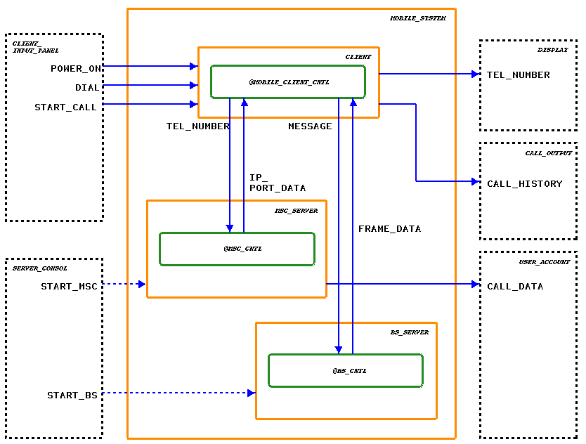
Activity-Chart: Mobile Phone System
Notes:
Client_Input_Panel, Server_Consol, Display, Call_Output, User_Account – External activities of the system. These tasks are performed not by the systems but by other factors like operator entering the data etc.
Client, MSC server, BS server – Internal activities of the system. They accept the input from the external activities and perform the required functions. The task may be assigning port# to the client, receiving and sending of frames etc.
Mobile_Client_Control, MSC_Control, BS_Control – Control activity of the system. There behavior is explained in the statecharts.

Slide 55
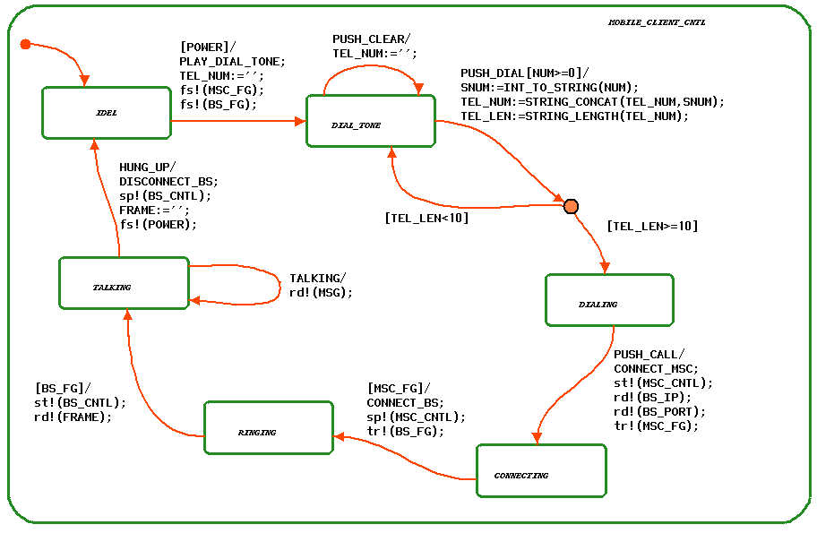
Statechart of Client: Mobile Phone System
Notes:
The figure shows the control behavior of Mobile_Client_Control (present in the previous slide).
Shows the entire cycle of how client initiates a call, connects to the number he dialed, and all the operation until he has hung up the phone from the client’s perspective.
The data on the transitions gives the various guard conditions and actions that take place upon when the condition evaluates to true. The data in “[]” represents the guard conditions and the functions after the “/” represents the actions.
The default entry state is: The client is Idle.

Slide 56
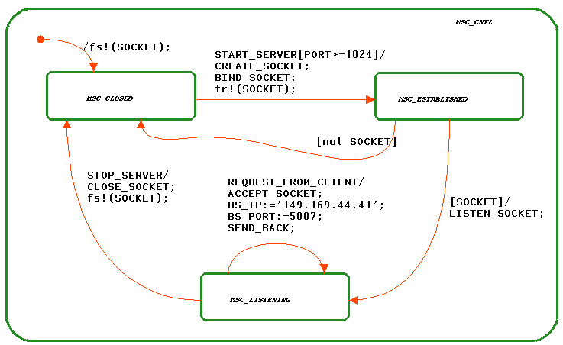
Statechart of MSC: Mobile Phone System
Notes:
The figure shows the control behavior of MSC_Control (present in the Activitychart slide).
Shows the entire cycle of how MSC server listens to a request form the client.
If the MSC server has a free port#, it assigns it to the client and listens on that port.
As and when the client hangs up the phone, the MSC server closes that socket connection and assigns it to new one as the request from client is received.

Slide 57
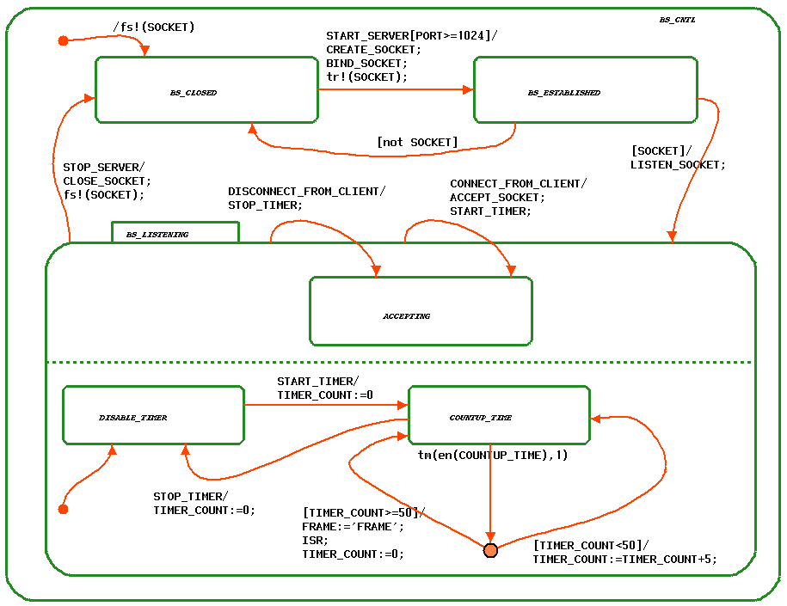
Statechart of BS: Mobile Phone System
Notes:
The figure shows the control behavior of BS_Control (present in the Activitychart slide).
The figure shows the super state BS_Listening. This checks the conditions that the client is receiving a frame from BS every 50ms.
Once the connection has been established the messages are sent to-and-fro between the client BS-Control and client.

Slide 58
STATEMATE simulation
Statemate model is a formal model that can be simulated and automatically translated into code.
System behavior is validated as an integral part of the design process before anything is built.
Statemate simulator can provide traditional debugging: monitors, and debugger windows. This allows the user to analyze the specification in order to ensure that its behavior is correct and to capture the test data that will be used later to test the implementation.
The Statemate system can generate high quality C code for software developer, and VHDL/Verilog code for hardware engineers.
The software creates a virtual prototype for operation on a workstation or PC, or code that runs on the target testbench system.

Slide 59
Further Info
Statemate MAGNUM
  ILogix → Telelogic → IBM (Rational Software)
  http://www-01.ibm.com/software/rational

Slide 60
Overview
Harel’s StateCharts
UML Statecharts
Statemate
SDL
SystemC
SpecC
VHDL, Verilog, SystemVerilog
Simulink
C, C++, Java

Slide 61
Specification and Description Language (SDL)
Designed to model distributed systems
  Dates back to early 70s
  Formal semantics defined in the late 80s
  Defined by ITU (International Telecommunication Union): Z.100 recommendation in 1980. Updates in 1984, 1988, 1992, 1996 and 1999
Based on asynchronous message passing
Provides both textual as well as graphical
Processes (represent extended FSMs) are the basic elements
Processes can perform operations on data
Contains programming language elements such as procedures

Slide 62
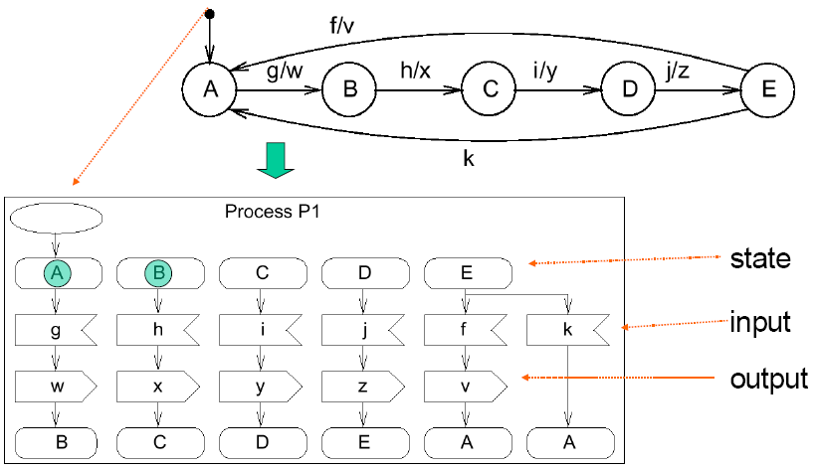
SDL-representation of FSMs/processes

Slide 63
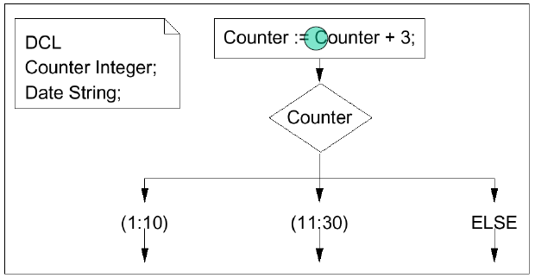
Operations on data
Variables can be declared locally for processes. Their type can be predefined or defined in SDL itself. SDL supports abstract data types (ADTs). Examples:

Slide 64
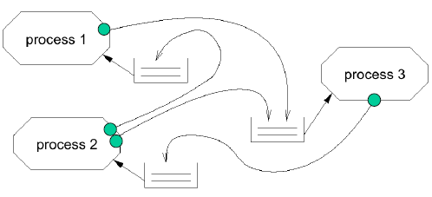
Communication among SDL-FSMs
Communication between FSMs (or “processes“) is based on message-passing, assuming a potentially indefinitely large FIFO-queue.
Each process :
  fetches next entry from FIFO,
  checks if input enables transition,
  if yes: transition takes place,
  if no: input is ignored

Slide 65
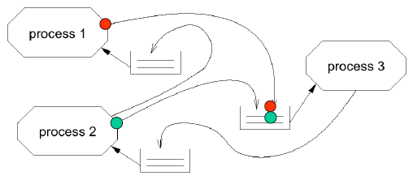
Deterministic?
Let tokens be arriving at FIFO at the same time: Order in which they are stored is unknown.
All orders are legal: simulators can show different behaviors for the same input, all of which are correct.

Slide 66
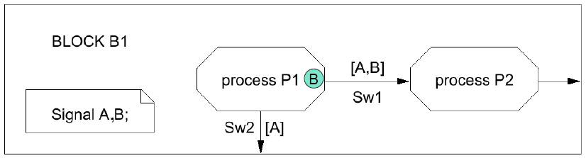
Process interaction diagrams
Interaction between processes can be described in process interaction diagrams (special case of block diagrams). In addition to processes, these diagrams contain channels and declarations of local signals. Example:

Slide 67
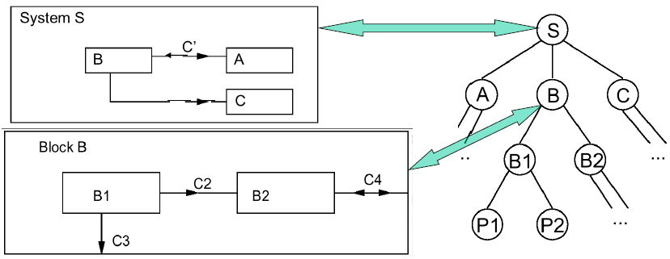
Hierarchy is SDL
Process interaction diagrams can be included in blocks. The root block is called system.
Processes cannot contain other processes, unlike in StateCharts.

Slide 68
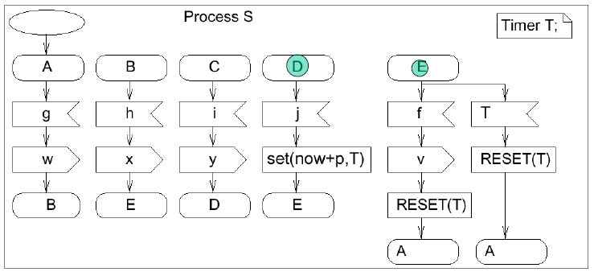
Timers
Timers can be declared locally. Elapsed timers put signal into queue (not necessarily processed immediately). RESET removes timer (also from FIFO-queue).

Slide 69
Larger example: vending machine
Machine selling pretzels, chips, cookies, and doughnuts.
Accepts nickels, dimes, quarters, and half-dollar coins.
Not a distributed application.
[] J.M. Bergé, O. Levia, J. Roullard: High-Level System Modeling, Kluwer Academic Publishers, 1995.

Slide 70
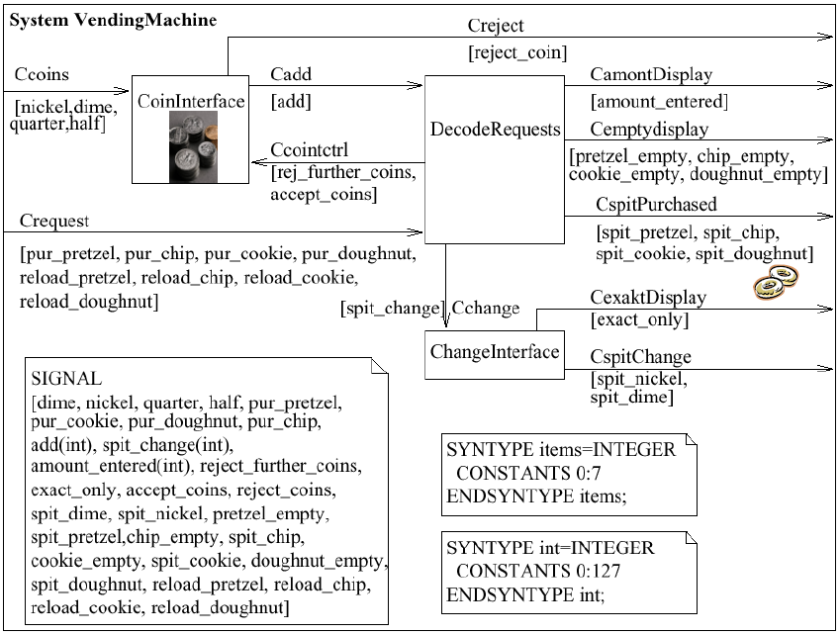

Slide 71
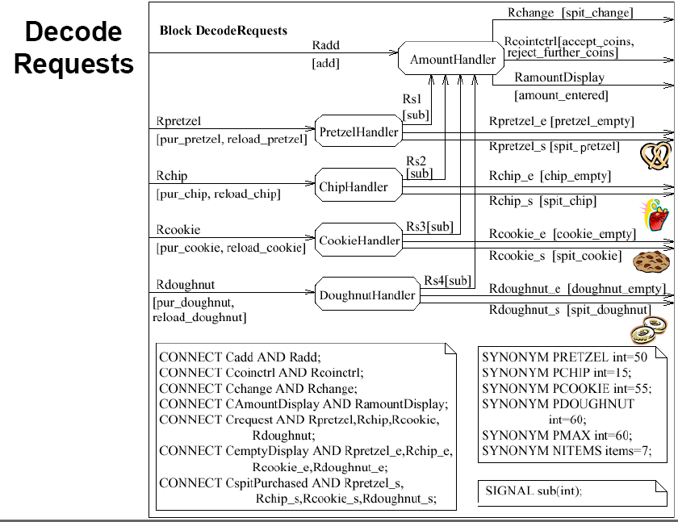

Slide 72
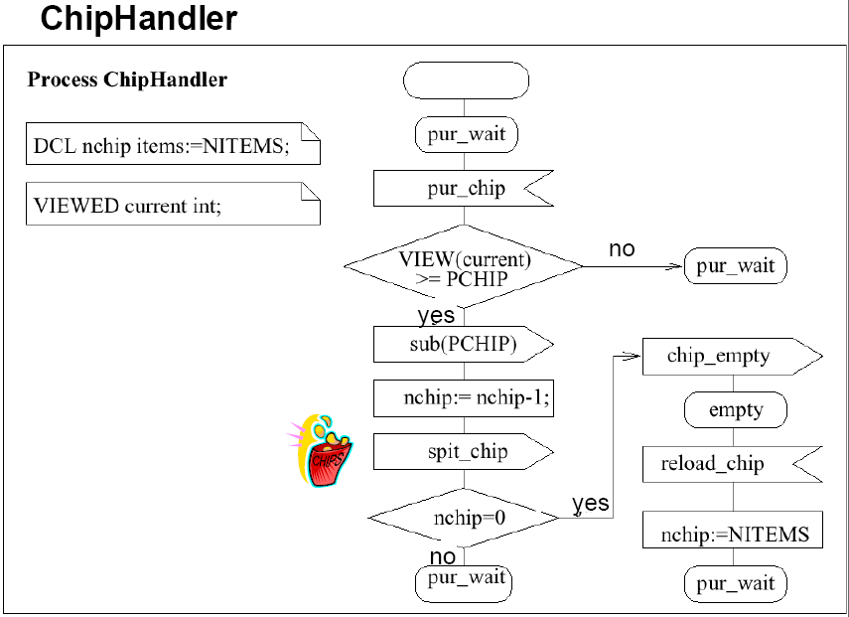

Slide 73
Conclusion
MoC: finite state machine components + non-blocking message passing communication
SDL is excellent for real-time, interactive and distributed systems
Not necessarily deterministic
Reliable implementations require the knowledge of a upper bound on the FIFOs length
Timer concept is sufficient for soft deadlines but not for hard deadlines
Hierarchies are supported
No full programming support, no description of non-functional properties
Commercial tools: SINTEF, Telelogic, Cinderella
Becoming less popular

Slide 74
Further info
http://ls12-www.cs.tu-dortmund.de/daes/media/documents/staff/marwedel/es-book/slides10/es-marw-2.03-sdl-df.ppt
ITU standards and recommendations
  www.itu.ch
SDL Forum Society
  www.sdl-forum.org
Conferences and workshops
  Bi-annual SDL
  SDL&MSC Workshop SAM

Slide 75
Overview
Harel’s StateCharts
UML Statecharts
Statemate
SDL
SystemC
SpecC
VHDL, Verilog, SystemVerilog
Simulink
C, C++, Java

Slide 76
SystemC: Motivation
Many standards (e.g. the GSM and MPEG-standards) are published as C programs
  Standards have to be translated if special hardware description languages have to be used
The functionalities of systems are provided by a mix of hardware and software components
  Simulations require an interface between hardware and software simulators unless the same language is used for the description of hardware and software
  Attempts to describe software and hardware in the same language.
    Various C dialects used for hardware description

Slide 77
SystemC: Features
Requirements and solutions for modeling HW in a SW language:
C++ class library including required functions.
Concurrency: via processes, controlled by sensivity lists and calls to wait primitives.
Time: Floating point numbers in SystemC 1.0 and Integer values in SystemC 2.0; Units ps, ns, µs etc*.
Support of bit-datatypes: bitvectors of different lengths; multiple-valued logic (2 and 4; resolution*)
Communication: plug-and-play channel model, allowing easy replacement of intellectual property
Deterministic behavior not guaranteed.

Slide 78
SystemC Language Architecture
Channels for MoCs
Kahn process networks, SDF, etc
Methodology-specific Channels
Master/Slave library
Elementary Channels
Signal, Timer, Mutex, Semaphore, FIFO, etc
Core Language
Module
Ports
Processes
Events
Interfaces
Channels
Event-driven simulation kernel
Data types
Bits and bit-vectors
Arbitrary precision integers
Fixed-point numbers
4-valued logic types, logic-vectors
C++ user defined types
C++ Language Standard

Slide 79
SystemC
HW #5:
  Download SystemC http://www.accellera.org/downloads/standards/systemc
  Work/change selected examples as discussed in class

Slide 80
Further Info
Thorsten Grotker, Stan Liao, Grant Martin, Stuart Swan, System Design with SystemC, Kluwer Academic Publishers, May 2002.
http://www.systemc.org/home
http://www.systemc-ams.org
http://www.engr.colostate.edu/~sudeep/teaching/ppt/lec03_sysc_tutorial.ppt
http://www-ti.informatik.uni-tuebingen.de/~systemc
http://www.asic-world.com/systemc/tutorial.html
http://www.ht-lab.com/howto/vh2sc_tut/vh2sc_tut.html
http://www.doulos.com/knowhow/systemc/tutorial

Slide 81
Overview
Harel’s StateCharts
UML Statecharts
Statemate
SDL
SystemC
SpecC
VHDL, Verilog, SystemVerilog
Simulink
C, C++, Java

Slide 82
SpecC
SpecC is based on the clear separation between communication and computation. Enables plug-and-play for system components; models system as hierarchical networks of behaviors communicating through channels.
SpecC specifications consists of behaviors, channels and interfaces.
Behaviors include ports, locally instantiated components, private variables and functions and a public main function.
Channels encapsulate communication. They include variables and functions, used for the definition of a communication protocol.
Interfaces are linking behaviors and channels together. They declare the communication protocols which are defined in a channel.

Slide 83
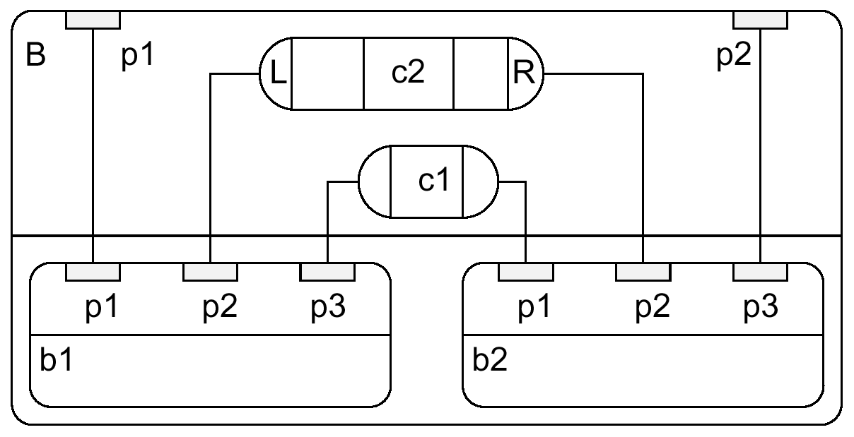
Example
channel
behavior

Slide 84
Example
interface L {void Write(int x);};
interface R {int Read (void);};
channel C implements L,R {
int Data; bool Valid;
void Write(int x) {
Data=x; Valid=true; }
int Read(void) { while (!Valid) waitfor(10); return (Data); }
behavior B1 (in int p1, L p2, in int p3) {
void main(void) {/*...*/ p2.Write(p1);} };
behavior B2 (out int p1, R p2, out int p3) {
void main(void) {/*...*/ p3=p2.Read(); } };
behavior B(in int p1, out int p2) {
int c1; C c2; B1 b1(p1,c2,c1); B2 b2 (c1,c2,p2);
void main (void) { par {b1.main();b2.main(); }}
};

Slide 85
Further Info
Daniel D. Gajski, Jianwen Zhu, Andreas Gerstlauer, Shuqing Zhao, SpecC: specification language and methodology, Springer, 1st edition, 2000.
http://www.cecs.uci.edu/~gajski
http://www.cecs.uci.edu/~specc
http://ls12-www.cs.tu-dortmund.de/daes/en/daes/mitarbeiter/prof-dr-peter-marwedel/embedded-system-text-book/slides/slides-2011.html

Slide 86
Overview
Harel’s StateCharts
UML Statecharts
Statemate
SDL
SystemC
SpecC
VHDL, Verilog, SystemVerilog
Simulink
C, C++, Java

Slide 87
VHDL
HDL = hardware description language
Textual HDLs replaced graphical HDLs in the 1980s (better for complex behavior).
1980: Definition started by DoD in 1980
1984: first version of the language defined, based on ADA, PASCAL
1987: IEEE standard 1076; 1992 revision;
Recently: VHDL-AMS models analog

Slide 88
Entities and Architectures
Each design unit is called an entity.
Entities are comprised of entity declarations and
Each architecture includes a model of the entity. By default, the most recently analyzed architecture is used. The use of another architecture can be requested in a configuration one or several architectures.

Slide 89
Entity Declaration
entity full_adder is
port(a, b, carry_in: in Bit; -- input ports
sum,carry_out: out Bit); --output ports
end full_adder;

Slide 90
Architectures
architecture behavior of full_adder is
begin
sum <= (a xor b) xor carry_in after 10 Ns;
carry_out <= (a and b) or (a and carry_in) or
(b and carry_in) after 10 Ns;
end behavior;
Architectural bodies can be
- behavioral bodies or - structural bodies.
Bodies not referring to hardware components are called behavioral bodies.

Slide 91
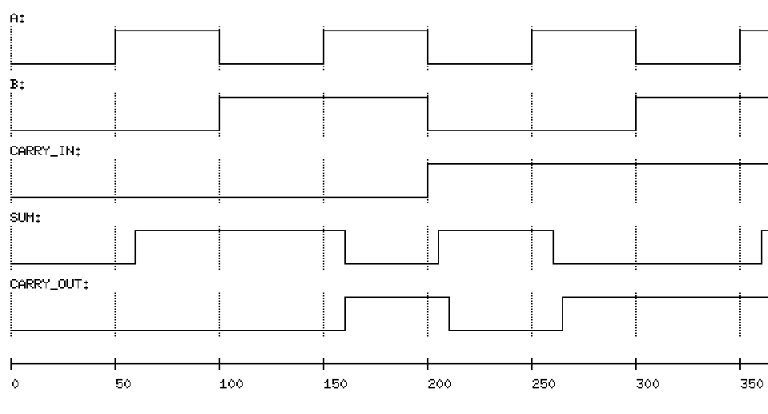
Simulation output

Slide 92
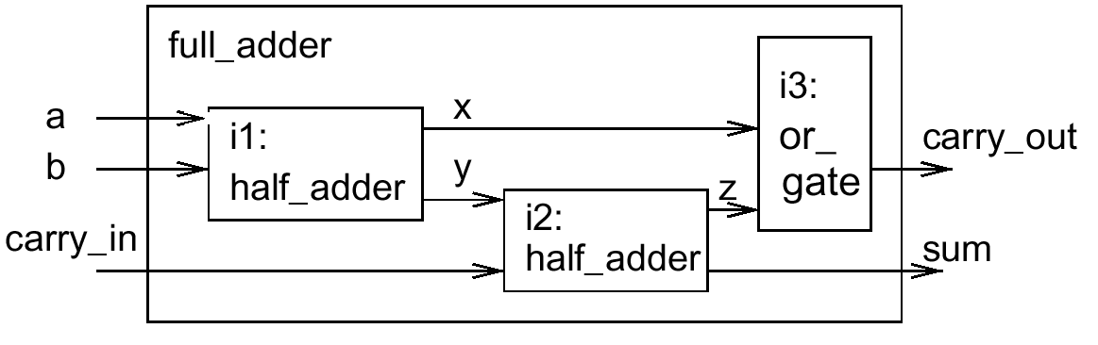
Structural Bodies
architecture structure of full_adder is
component half_adder
port (in1,in2:in Bit; carry:out Bit; sum:out Bit);
end component;
component or_gate
port (in1, in2:in Bit; o:out Bit);
end component;
signal x, y, z: Bit; -- local signals
begin -- port map section
i1: half_adder port map (a, b, x, y);
i2: half_adder port map (y, carry_in, z, sum);
i3: or_gate port map (x, z, carry_out);
end structure;

Slide 93
VHDL processes
Processes model parallelism in hardware.
General syntax:
label: --optional
process
declarations --optional
begin
statements --optional
end process
a <= b after 10 ns is equivalent to
process
begin
a <= b after 10 ns
end

Slide 94
Wait statements
Four possible kinds of wait-statements:
wait on signal list;
  wait until signal changes;
  Example: wait on a;
wait until condition;
  wait until condition is met;
  Example: wait until c='1';
wait for duration;
  wait for specified amount of time;
  Example: wait for 10 ns;
wait;
  suspend indefinitely

Slide 95
Sensitivity Lists
Sensivity lists are a shorthand for a single wait on-statement at the end of the process body:
process (x, y)
begin
prod <= x and y ;
end process;
is equivalent to
process
begin
prod <= x and y ;
wait on x,y;
end process;

Slide 96
VHDL: Summary
Behavioral hierarchy (procedures & functions)
Structural hierarchy but no nested processes
No object-orientation
Static number of processes
Complicated simulation semantics
Too low level for initial specification
Good for intermediate language for hardware generation

Slide 97
Verilog
HW description language competing with VHDL
Standardized:
  IEEE 1364-1995 (Verilog version 1.0)
  IEEE 1364-2001 (Verilog version 2.0)
Features similar to VHDL:
  Designs described as connected entities
  Bit-vectors and time units are supported
Features that are different:
  Built-in support for 4-value logic and for logic with 8 strength levels encoded in two bytes per signal.
  More features for transistor-level descriptions
Less flexible than VHDL.
More popular in the US (VHDL common in Europe)

Slide 98
Representation: Structural Models
Structural models
  Built from gate primitives and/or other modules
  They describe the circuit using logic gates — much as we would see in an implementation of a circuit
module mux
(output f,
input a, b, sel);
and #5 g1 (f1, a, nsel),
g2 (f2, b, sel);
or #5 g3 (f, f1, f2);
not g4 (nsel, sel);
endmodule
a
f
b
sel
f = a • sel’ + b • sel

Slide 99
Example: Half Adder
Module testAdd (test bench) generated inputs for module halfAdd (design) and displayed changes
module testAdd(a, b, sum, cOut);
input sum, cOut;
output a, b;
reg a, b;
initial begin
$monitor ($time,,
“a=%b, b=%b, sum=%b, cOut=%b”,
a, b, sum, cOut);
a = 0; b = 0;
#10 b = 1;
#10 a = 1;
#10 b = 0;
#10 $finish;
end
endmodule
module tBench;
wire su, co, a, b;
halfAdd ad(su, co, a, b);
testAdd tb(a, b, su, co);
endmodule
module halfAdd (sum, cOut, a, b); output sum, cOut;
input a, b;
xor #2 (sum, a, b);
and #2 (cOut, a, b);
endmodule

Slide 100
Further Info
VHDL, Verilog: http://ls12-www.cs.tu-dortmund.de/daes/media/documents/staff/marwedel/es-book/slides11/es-marw-2.06-discrete-event.ppt

Slide 101
Other languages/environments
SCE (ESE is a toolset for modeling, synthesis and validation of multi-processor embedded system designs): http://www.cecs.uci.edu/~cad/sce.html
SPARK (C-to-VHDL high-level synthesis framework): http://mesl.ucsd.edu/spark
SpecCharts: Combination of StateCharts and VHDL; designed by Gajski et al. (UC Irvine)
MATLAB (Matrix Laboratory): facility for defining matrix-based computations, extending numerical FORTRAN packages LINPACK and EISPACK with a GUI
Simulink: GUI-based specification of control systems, uses MATLAB for solving these problems.
Esterel: reactive language; synchronous; all reactions are assumed to be in 0 time; communication based on instantenous broadcast;
  www.esterel-technologies.com

Slide 102
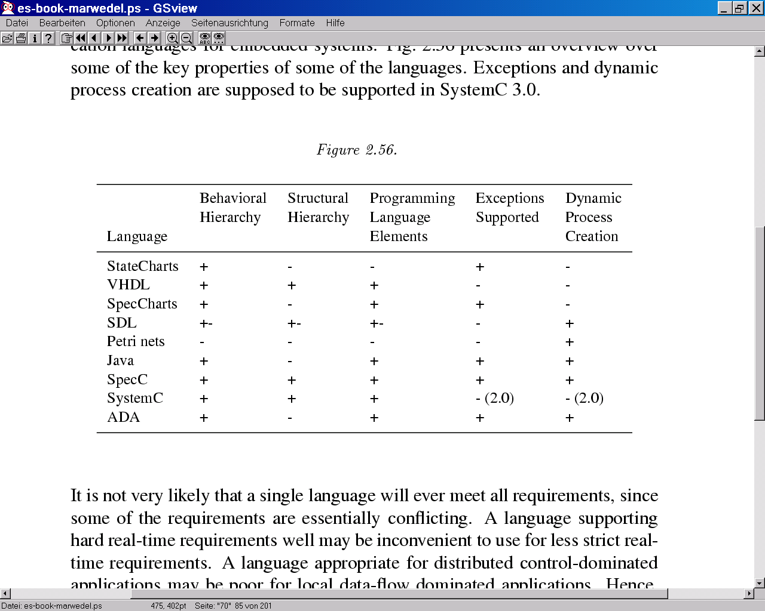
Language Comparison

Slide 103
Levels Covered by Different Languages

Slide 104
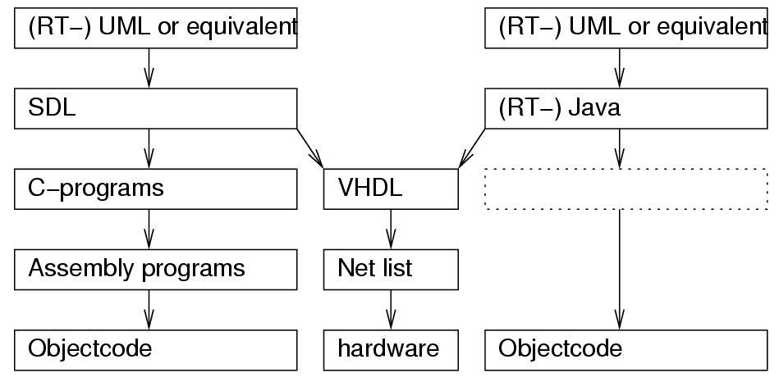
Language Problems in Practice
To overcome limitations of individual languages, need to use combination of languages

